Slide 1

Student Attrition
A Predictive Understanding
Trinity University Business Analytics
in association with KIPP San Antonio

Slide 2

Objective
Develop a predictive model of student attrition:
Include an analysis of exit survey text responses to identify common issues and causes
Determine whether certain reasons are more predictable than others or more highly correlated with one of the noted factors.
Determine how predictive “newness” is and/or when “newness” is no longer a factor in student attrition.
Notes:
Linear Line represents the average. Grades are proven to be higher in students who had no attrition. The graph represents a student number as they arrive to a KIPP school. A high student number correlates to a high ID number meaning the student is fairly new at the school. A new student may have no grades or less grades making the linear average negative.

Slide 3
Independent Variables
Student attendance
Students’ disciplinary records
Student grades
MAP standardized test scores
Geographical distance between students’ homes and their schools
Newness of the student (length of enrollment)
Text responses for the parent exit survey at time of student withdrawal
Notes:
Linear Line represents the average. Grades are proven to be higher in students who had no attrition. The graph represents a student number as they arrive to a KIPP school. A high student number correlates to a high ID number meaning the student is fairly new at the school. A new student may have no grades or less grades making the linear average negative.

Slide 4
Scatter Plots
Data compiled from 2010-2016
Used Unique ID’s to gather student totals
Stayed: 2536
Withdrew: 1771
The larger the “student number,” the less time enrolled at KIPP (more recently assigned an ID)

Slide 5
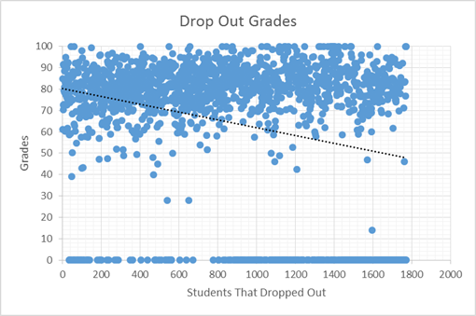
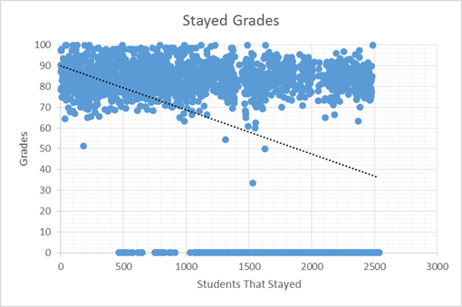
Grades
Notes:
Linear Line represents the average. Grades are proven to be higher in students who had no attrition. The graph represents a student number as they arrive to a KIPP school. A high student number correlates to a high ID number meaning the student is fairly new at the school. A new student may have no grades or less grades making the linear average negative.

Slide 6
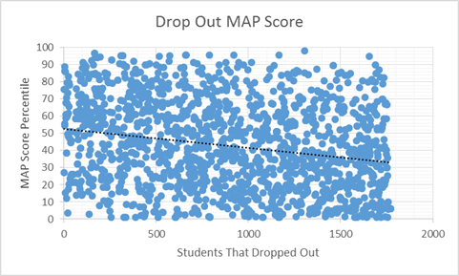
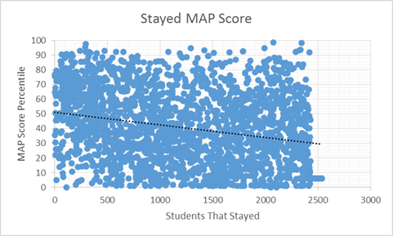
MAP Standardized Test Scores
Notes:
No significant difference in MAP score average between student attrition and non student attrition.

Slide 7
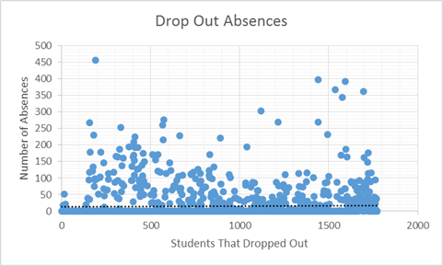
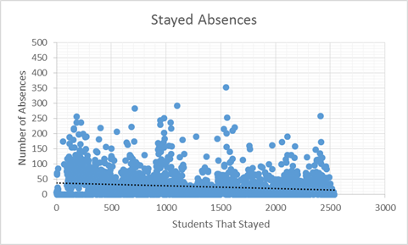
Absences
Notes:
Attrition Absences rise over time, even with newer students coming in. As students without attrition average a steady amount of absences depending on the length of enrollment. Looking at the scale students with attrition also have more students miss more than 350 days of school compared to students with no attrition.

Slide 8
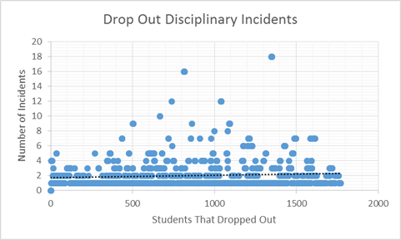
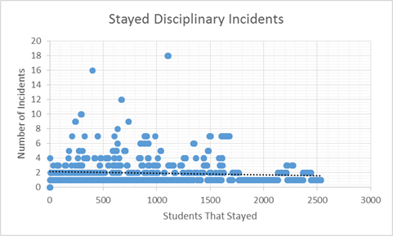
Disciplinary Incidents
Notes:
Students newly enrolled in the school with attrition average more disciplinary incidents than students who have been enrolled longer with no attrition. The average hovers around two incidents.

Slide 9
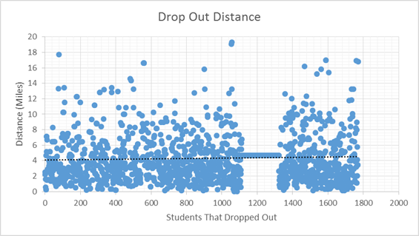
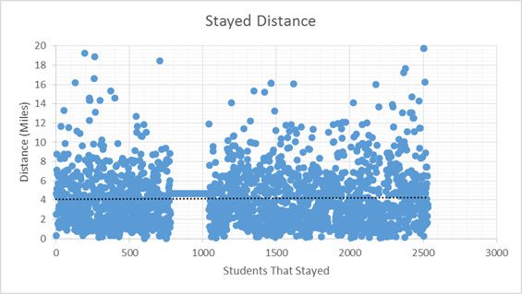
Distance to KIPP
Notes:
The average distance is around 4 miles, however more students with attrition have a farther distance to travel than students with no attrition. We can see this from the scale. This can be a result of not updating a new address or updating a new address that is not relevant.

Slide 10
Correlation
Audience, please refer to handout
Important points:
Time enrolled, Grades have overall pronounced negative correlation to Attrition
Strong Relationship between Grades and MAP score
Lower autocorrelation across the board for students who withdrew
Students who stayed have relatively strong positive correlation between variables that would logically lead them to stay, and relatively strong negative correlation for those that would logically promote withdrawal

Slide 11
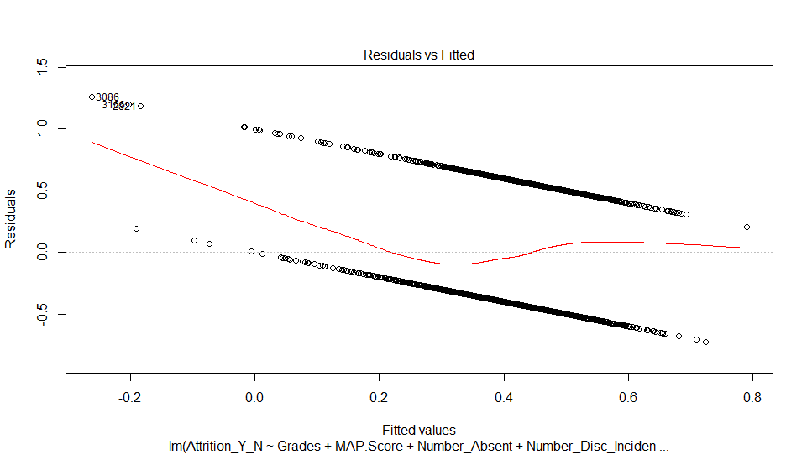
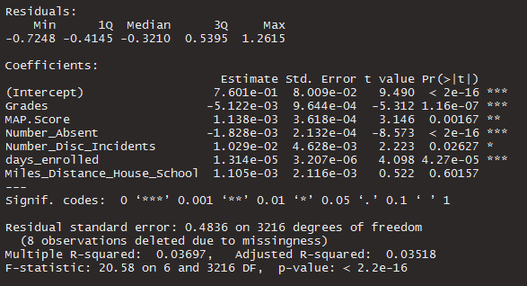
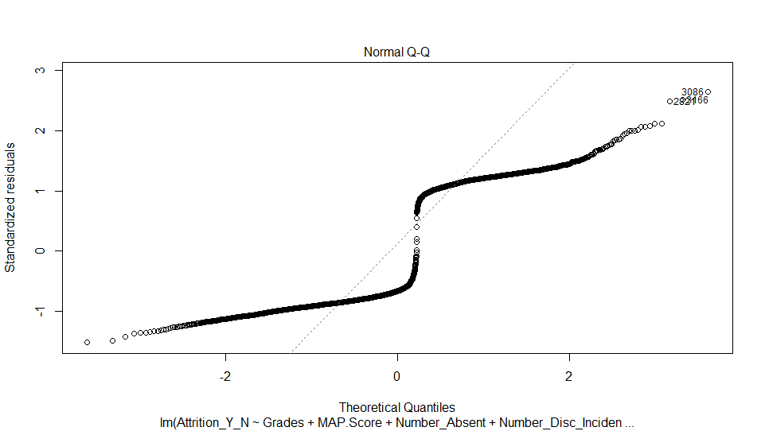
Linear Models - Full Dataset

Slide 12
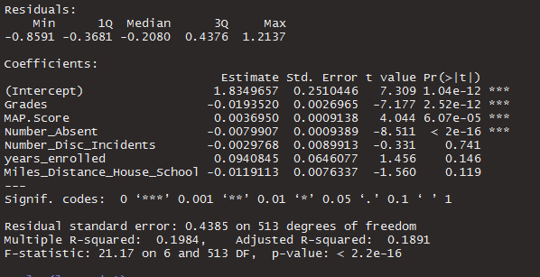
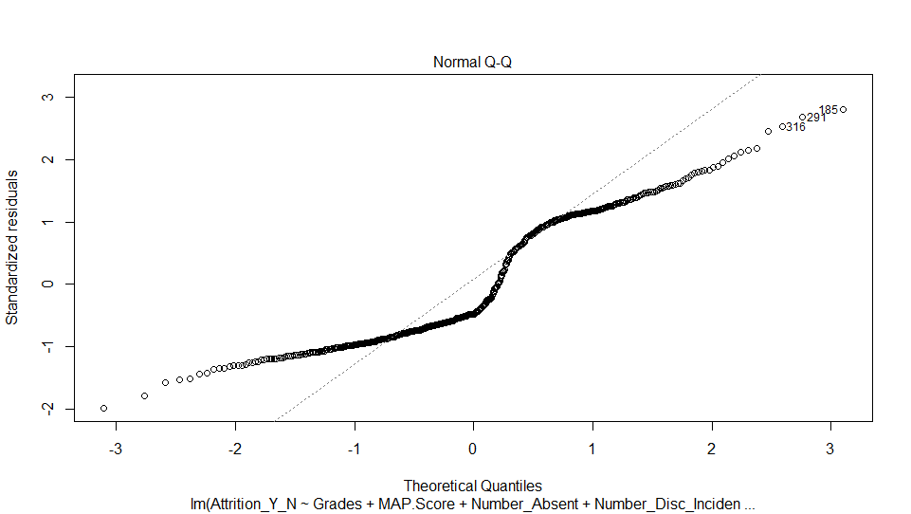
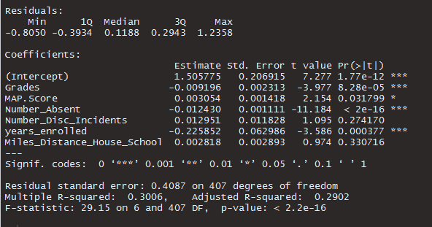
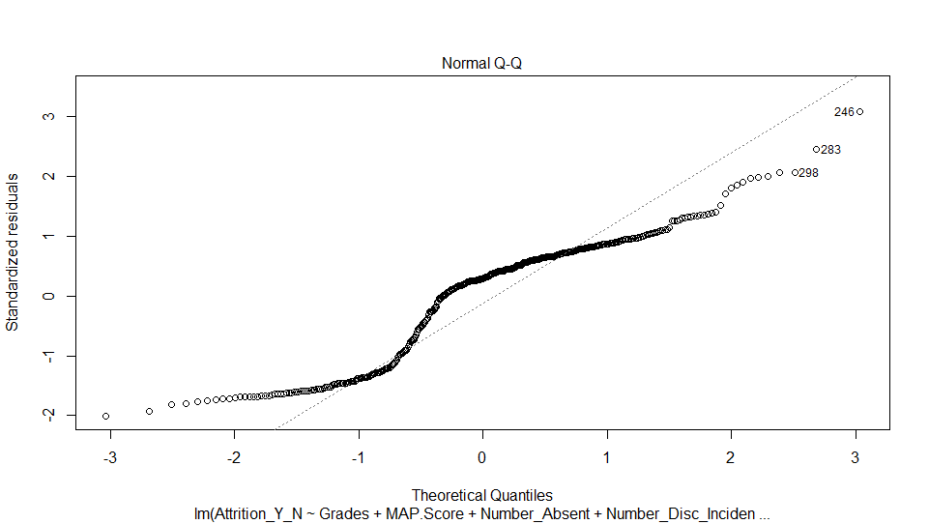
Linear Models - Clustered Samples

Slide 13
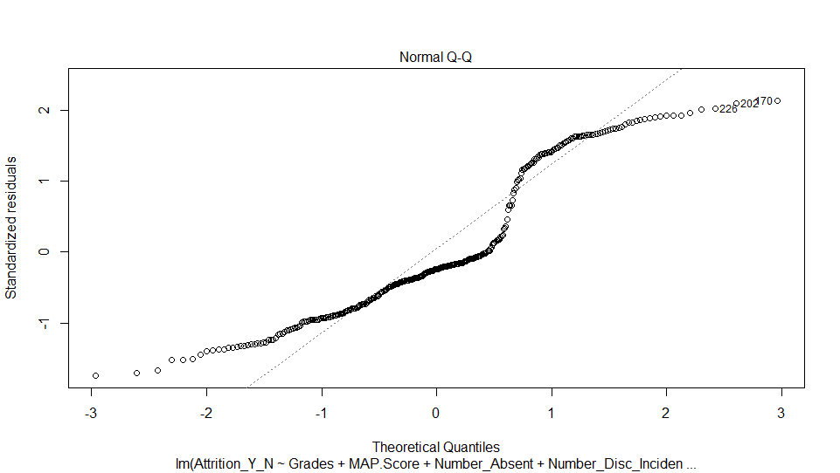
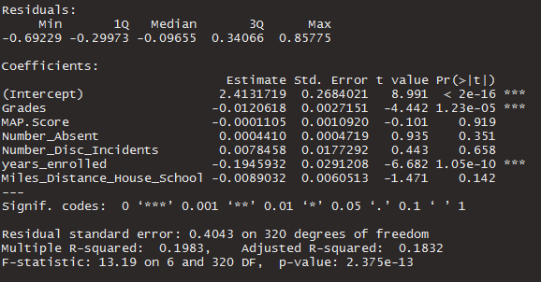
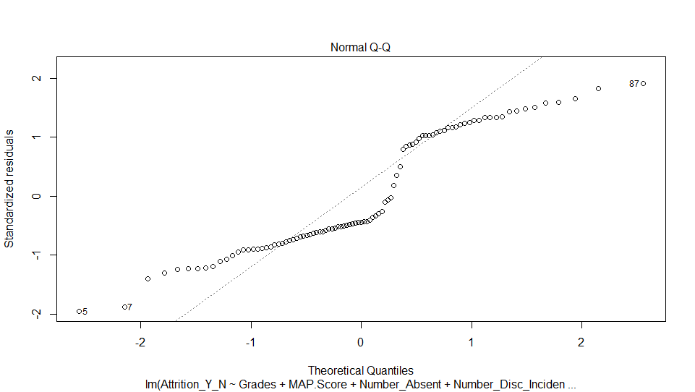
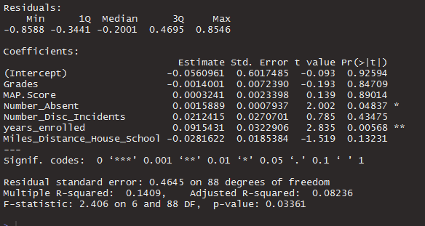
Linear Models - Clustered Samples

Slide 14
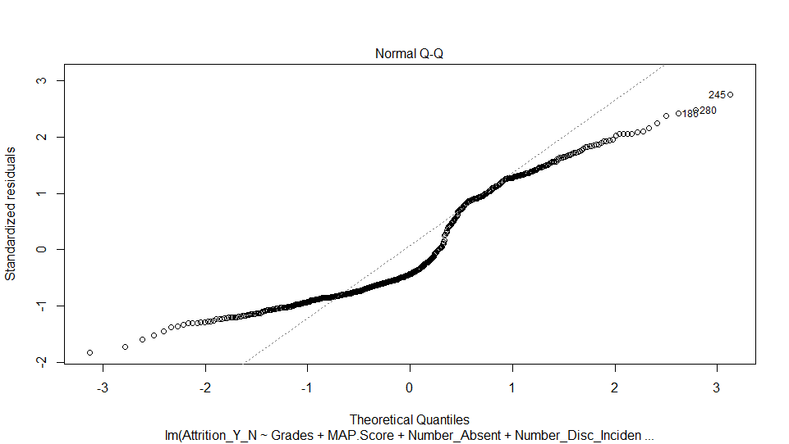
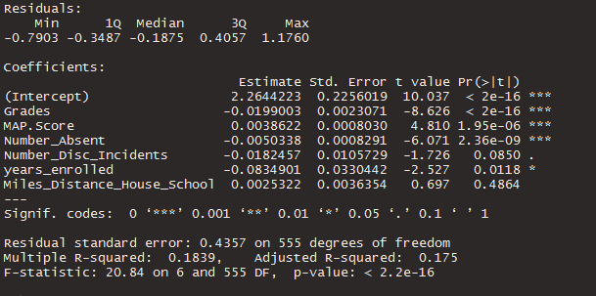
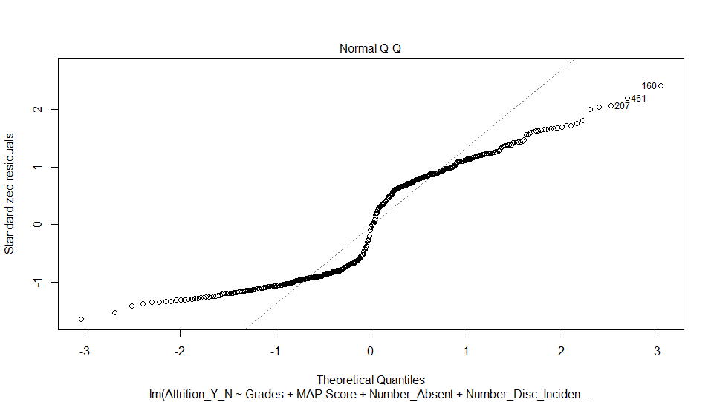
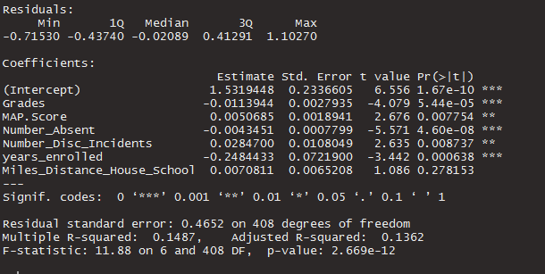
Linear Models - Clustered Samples

Slide 15







Prediction Results
Full dataset:
Cluster 1: Cluster 4:
Cluster 2: Cluster 5:
Cluster 3: Cluster 6:

Slide 16
Classification
Audience, please refer to handout
Larger variance among students that leave KIPP
Similar characteristics between students leaving KIPP and staying
Notes:
students leave for different reasons, but students with certain characteristics may have similar reason. cluster students with the given variables we could study the representation of each group. This is just like taking samples out the entire students body, but the sample here is more representative than random samples.
Handout, two classification on students left kipp and staying;

Slide 17
Case Analysis on Students leaving KIPP
About 270 students with high academic performance dropped out close to 1 full academic year.
Group 1
Grade MAP Absence Discipline Weeks enrolled Year Enroll Distance
82.77 65.40 3.18 1.97 45.15 0.86 4.65
Good academic performance
Short enrollment length
Transportation, relocation of family, social support, school culture and policy;
Notes:
Special attention to certain groups -- group 1

Slide 18
Case Analysis on Students leaving KIPP
Students may leave for insufficient achievement in academics.
Group 6
Grade MAP Absence Discipline Weeks enrolled Year Enroll Distance
81.25 22.44 0.69 2.09 57.00 1.09 4.54
Group 12
Grade MAP Absence Discipline Weeks enrolled Year Enroll Distance
80.10 24.16 3.00 2.19 19.95 0.38 4.04
141 students in Group 6, 150 in Group 12
Large Discrepancy between grades and MAP score
High grades/class performance
Conversely, low MAP scores (percentile)
Stay around over 1 year in Group 6, but only 1 semester for Group 12
Notes:
one reason inferred from the characteristics is academic achievement
trying pretty hard, but not getting good MAP score;

Slide 19
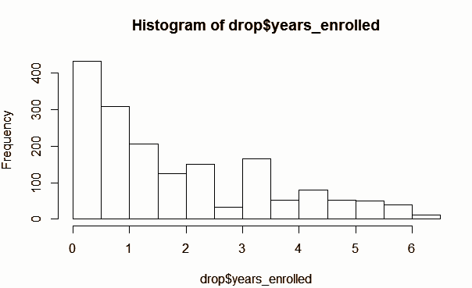
Enrollment Length
The first semester has the highest dropout rate by a large margin.

Slide 20
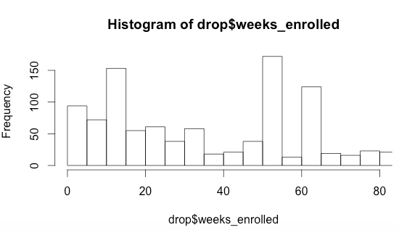
Enrollment Length (Weeks) for the First Three Semesters
High points:
Weeks 10-15 (~ ⅔ through first semester)
Weeks 50-55 (start of next school year)
Weeks 60-65
Notes:
Week 10 to 15 has the highest drop out rate in first semster

Slide 21
2016 Text Analysis
Social, emotional, behavioral:
-Smaller class size?
- Unsafe (parent’s opinion of environment - bullying etc.)
2. Family relocation:
-New address is too far or inconvenient to stay, switches schools
3. Other:
-Parent disapproval of KIPP
4. Transportation:
-Bus stops are inconvenient or unsafe for child

Slide 22
Conclusions & Recommendations
Variables as given/built not predictive of student attrition in a significant manner, despite logical connections
However, clustering analysis shows there are indeed important discrete groups among the student body
Try to reach the needs of different classes of students in different ways
Orientation program cannot go as far as 15th-week attrition peak, but may combat earlier attrition

Slide 23


